Slide 1
Subordinate Clauses with Subjunctive and Optative Moods
Prof. Vanessa Gorman
University of Nebraska-Lincoln
vgorman1@unl.edu

Slide 2
Four Greek Moods
Each conjugated verb has person-number-tense-mood-voice
Indicative – normal declarative statements
Imperative – commands (later)
Subjunctive – assumption or possibility; unreal statements
Often with ἄν
Optative – wish or potentiality
Sometimes with ἄν

Slide 3
Subjunctive
Three tenses representing aspect
Present = action in progress/on-going
Aorist = simple completed action
Perfect = completed action with results that continue into the present
In the first three books of Xenophon’s Hellenika
61 present subjunctives
60 aorist subjunctives
1 perfect subjunctives

Slide 4
Formation of Subjunctive
Lengthen the theme vowel; no augments in aorist
Use primary endings:
3rd sg act = -ει > -ῃ
3rd sg M/P = -εται > -ηται
3rd pl act = -ουσι(ν) > -ωσι(ν)
3rd pl M/P = -ονται > -ωνται
λύω; λείπω>ἔλιπον [3PP]
 | Pres Ind | Pres Subj | Weak Aor Subj | Strong Aor Subj
3rd sg act | λύει | λύῃ | λύσῃ | λίπῃ
3rd sg MP | λύεται | λύηται | λύσηται | λίπηται
3rd pl act | λύουσι(ν) | λύωσι(ν) | λύσωσι(ν) | λίπωσι(ν)
3rd pl MP | λύονται | λύωνται | λύσωνται | λίπωνται

Slide 5
Common Uses of the Subjunctive in Subordinate Clauses
Usually negated by μή; often accompanied by ἄν.
**Some conditional sentences
**Purpose clauses with ἵνα, ὅπως, ὡς [“in order that”]
Also other clauses that imply purpose
Usually after a main verb in pres, fut, or perf [i.e. “primary sequence”]
Some fear clauses (referring to the future)
Some indefinite relative or temporal clauses

Slide 6
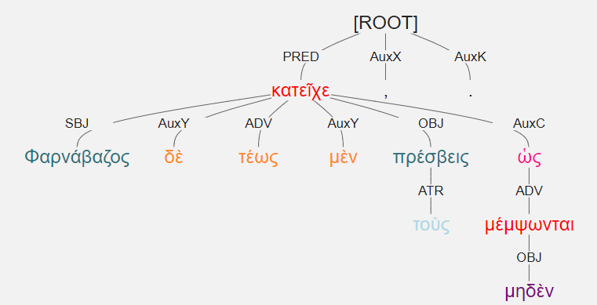
Φαρνάβαζος δὲ τέως μὲν κατεῖχε τοὺς πρέσβεις, ὡς μηδὲν μέμψωνται. [1.4.6]
Pharabazos detained the envoys for a while, so that they could not find any fault.
Negative purpose clause with ὡς + μή.

Slide 7
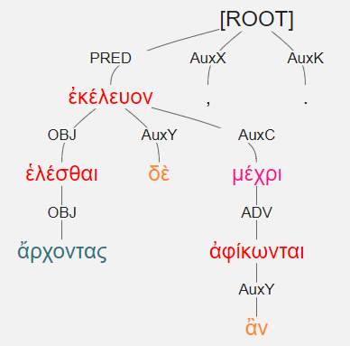
ἑλέσθαι δὲ ἐκέλευον ἄρχοντας, μέχρι ἂν ἀφίκωνται. [1.1.27]
They were ordering them to seize the archons until they should arrive.
Whenever that may be.
Indefinite temporal clause with μέχρι + ἄν

Slide 8
Optative
Three common tenses = present, aorist, future
Perfect and future perfect are rare
In the first three books of Xenophon’s Hellenika
189 present optatives
35 future optatives
79 aorist optatives
5 perfect optatives
0 future perfect optatives

Slide 9
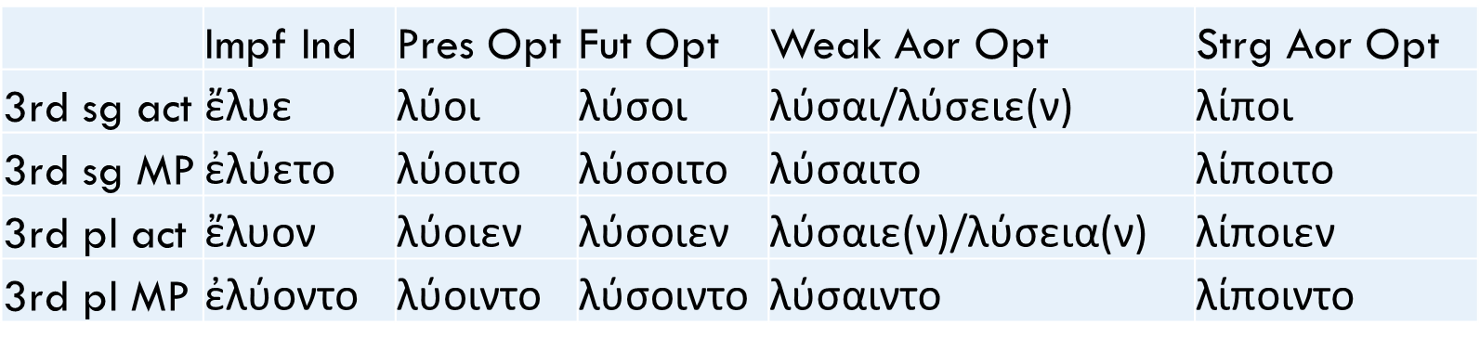
Formation of Optative
Iota is the mark of the optative; no augments in aorist!
Use secondary endings
3rd sg act = -ε(ν) > -οι
3rd sg M/P = -ετο > -οιτο
3rd pl act = -ον > -οιεν
3rd pl M/P = -οντο > -οιντο
λύω; λείπω>ἔλιπον [3PP]

Slide 10
Most Common Uses of the Optative in Subordinate Clauses
Usually negated by μή and often accompanied by ἄν.
Indirect statements and questions [Especially when the verb introducing the clause is in a past tense; i.e., secondary sequence]
Indicative used for primary sequence
In purpose clauses with ἵνα, ὅπως, ὡς [usually in secondary sequence]
Any conditionals or clauses indicating potentiality

Slide 11
Less Common Uses of the Optative in Subordinate Clauses
Causal clauses that allege a cause rather than stating a fact (indic)
ὅτι, ἐπεί, ὅτε, etc.
Especially in 2º sequence
Relative clauses referring to past habitual action
Temporal clauses referring to the future
Some fear clauses
Subordinate clause of a subordinate clause

Slide 12
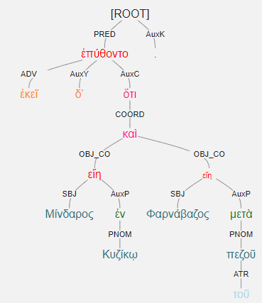
ἐκεῖ δʼ ἐπύθοντο ὅτι Μίνδαρος ἐν Κυζίκῳ εἴη καὶ Φαρνάβαζος μετὰ τοῦ πεζοῦ. [1.1.14]
There they learned that Mindaros was in Kyzikos and Pharnabazos was with the infantry.
Indirect statement with ὅτι after a main verb in the past tense.

Slide 13
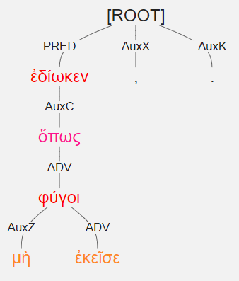
ἐδίωκεν, ὅπως μὴ ἐκεῖσε φύγοι. [1.6.15]
He was pursuing him so that he could not flee to that place.
Negative purpose clause after a verb in the past tense, with ὅπως + μὴ.

Slide 14
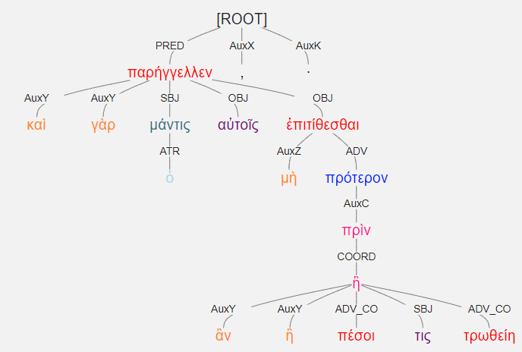
καὶ γὰρ ὁ μάντις παρήγγελλεν αὐτοῖς μὴ πρότερον ἐπιτίθεσθαι, πρὶν ἂν ἢ πέσοι τις ἢ τρωθείη· [2.4.18]
For the seer told them not to attack before someone was either killed or wounded.
Temporal clause referring to the future.
τις + ἄν indicates indefinite.

Slide 15
Review of Conditional Sentences
If … then statements
The “then” clause is independent.
It called is the apodosis.
“Then” is often unexpressed.
The “if” clause is dependent.
It is called the protasis.
εἰ or ἐὰν (εἰ+ἄν) = AuxC
It hangs on the verb of the apodosis
Verb of the protasis hangs on the εἰ and is labeled ADV

Slide 16
Conditional Sentences
Type | Protasis | Apodosis | Translation
Present Simple | εἰ + pr/pf indic | pr/pf indic | do/do
Past Simple | εἰ + impf/aor/pp indic | impf/aor/pp indic | did/did
Present Unreal | εἰ + impf indic | impf indic + ἄν | were/would
Past Unreal | εἰ + impf/aor indic | aor/impf indic + ἄν | had been/would have been

Slide 17
Conditional Sentences
Type | Protasis | Apodosis | Translation
Present Simple | εἰ + pr/pf indic | pr/pf indic | do/do
Past Simple | εἰ + impf/aor/pp indic | impf/aor/pp indic | did/did
Present Unreal | εἰ + impf indic | impf indic + ἄν | were/would
Past Unreal | εἰ + impf/aor indic | aor/impf indic + ἄν | had been/would have been
Present General | ἐάν + subj | pres indic | if ever do, do
Past General | εἰ + optative | impf indic [aor] | if ever did, did

Slide 18
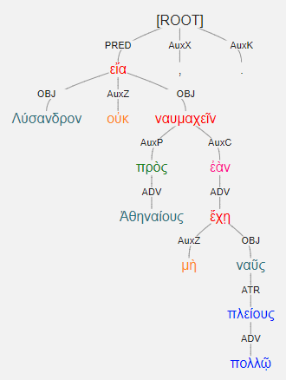
Present General [ἐάν + subj > pres indic]
Λύσανδρον οὐκ εἴα ναυμαχεῖν πρὸς Ἀθηναίους, ἐὰν μὴ πολλῷ πλείους ναῦς ἔχῃ. [2.1.14]
He was not allowing Lysander to sail out to fight the Athenians if he did not have many more ships.
“Until he had many more ships”
ἐὰν + μή + pres. subj.
Infinitive ναυμαχεῖν stands for finite present indic verb

Slide 19
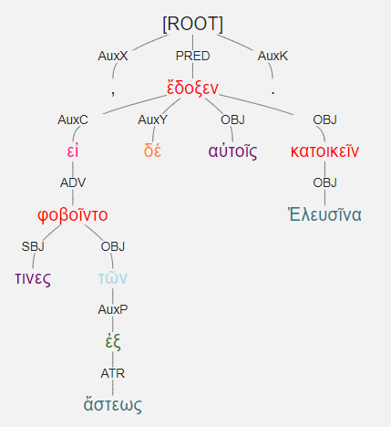
Past General [εἰ + optative > imperf indic]
εἰ δέ τινες φοβοῖντο τῶν ἐξ ἄστεως, ἔδοξεν αὐτοῖς Ἐλευσῖνα κατοικεῖν. [2.4.38]
If anyone was afraid of the men from the town, it seemed best to them to inhabit Eleusis.
εἰ + pres MP opt [middle sense]
Apodosis = aor instead of impf = one-time act

Slide 20
Conditional Sentences
Type | Protasis | Apodosis | Translation
Present Simple | εἰ + pr/pf indic | pr/pf indic | do/do
Past Simple | εἰ + impf/aor/pp indic | impf/aor/pp indic | did/did
Present Unreal | εἰ + impf indic | impf indic + ἄν | were/would
Past Unreal | εἰ + impf/aor indic | aor/impf indic + ἄν | had been/would have been
Present General | ἐάν + subj | pres indic | if ever do, do
Past General | εἰ + optative | impf indic [aor] | if ever did, did
Future More Vivid | ἐάν + subj | fut indic | do/will do
Future Less Vivid | εἰ + optative | optative + ἄν | should/would

Slide 21
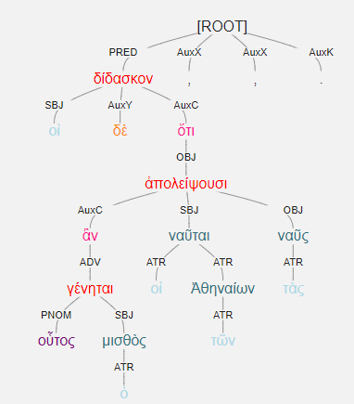
Future More Vivid [ἐάν/ἄν + subj > fut indic]
οἱ δὲ δίδασκον ὅτι, ἂν οὗτος ὁ μισθὸς γένηται, οἱ τῶν Ἀθηναίων ναῦται ἀπολείψουσι τὰς ναῦς. [1.5.4]
They were instructing him that, if this is the rate of pay, then the Athenian sailors will abandon their ships.
ἄν [ἐάν] + aor subj [dep]
Apodosis = fut indic

Slide 22
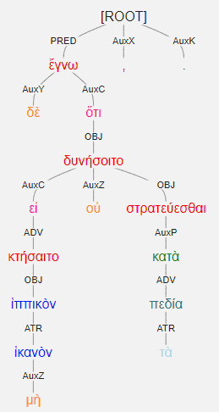
Future Less Vivid [εἰ + optative > optative + ἄν]
ἔγνω δὲ ὅτι εἰ μὴ ἱππικὸν ἱκανὸν κτήσαιτο, οὐ δυνήσοιτο κατὰ τὰ πεδία στρατεύεσθαι. [3.4.15]
He recognized that, if he should not possess sufficient cavalry, he would not be able to make war in the plains.
εἰ + μή + aor opt
Apodosis = fut opt [dep]

